Slide 1

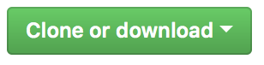

Welcome!
Please download all of the course material:
Do you have a github account? Give us a star! :)
and store it in a single, accessible folder on your computer. Don’t forget to unzip!
tinyurl.com/introRData > >

Slide 2
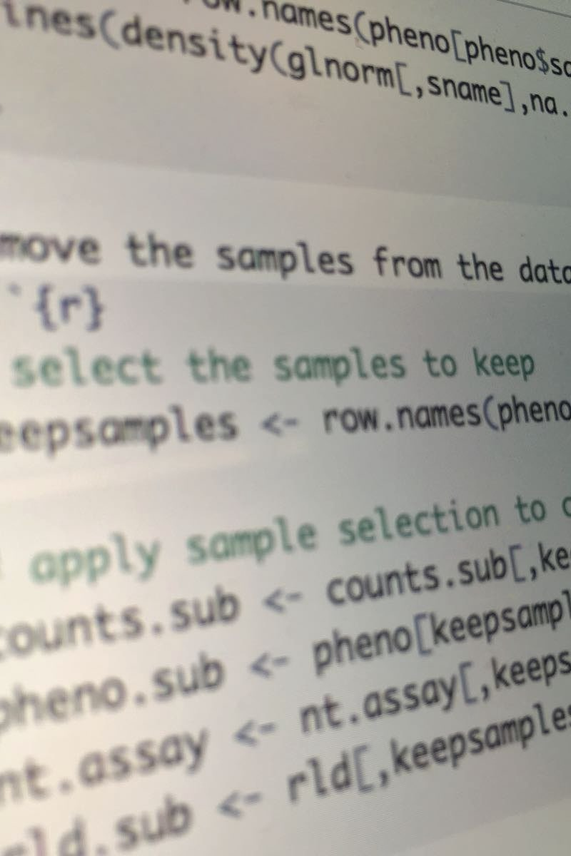
Introduction to R & data
Part I: Basics of R
Lunch (~12:15)
Part II: Modern R with tidyverse
Final remarks (~17:00)

Slide 3
Quick intro: this is us! And who are you?
Bianca Kramer
subject specialist Biomedical Science
UU Library
b.m.r.kramer@uu.nl
Barbara Vreede
subject specialist Science
UU Library
b.m.i.vreede@uu.nl
Felix Weijdema
subject specialist Biomedical Science
UU Library
f.p.weijdema@uu.nl
Jacques Flores
data specialist @ RDM support
j.p.flores@uu.nl

Slide 4
What’s with those sticky notes?
I need some assistance, please!
I have finished the exercise and am ready to move on!
No sticky note?

Slide 5
Introduction to R & data
Part 1: Basics of R

Slide 6
What is R?
Widely used programming language for data analysis
Based on statistical programming language S (1976)
Developed by Ross Ihaka & Robert Gentleman (1995)
Very active community, with many (often subject-specific) packages

Slide 7
We will work in RStudio
Integrated Development Environment for R
Founded by JJ Allaire, available since 2010
Bloody useful! Let’s take a look: please open RStudio!

Slide 8
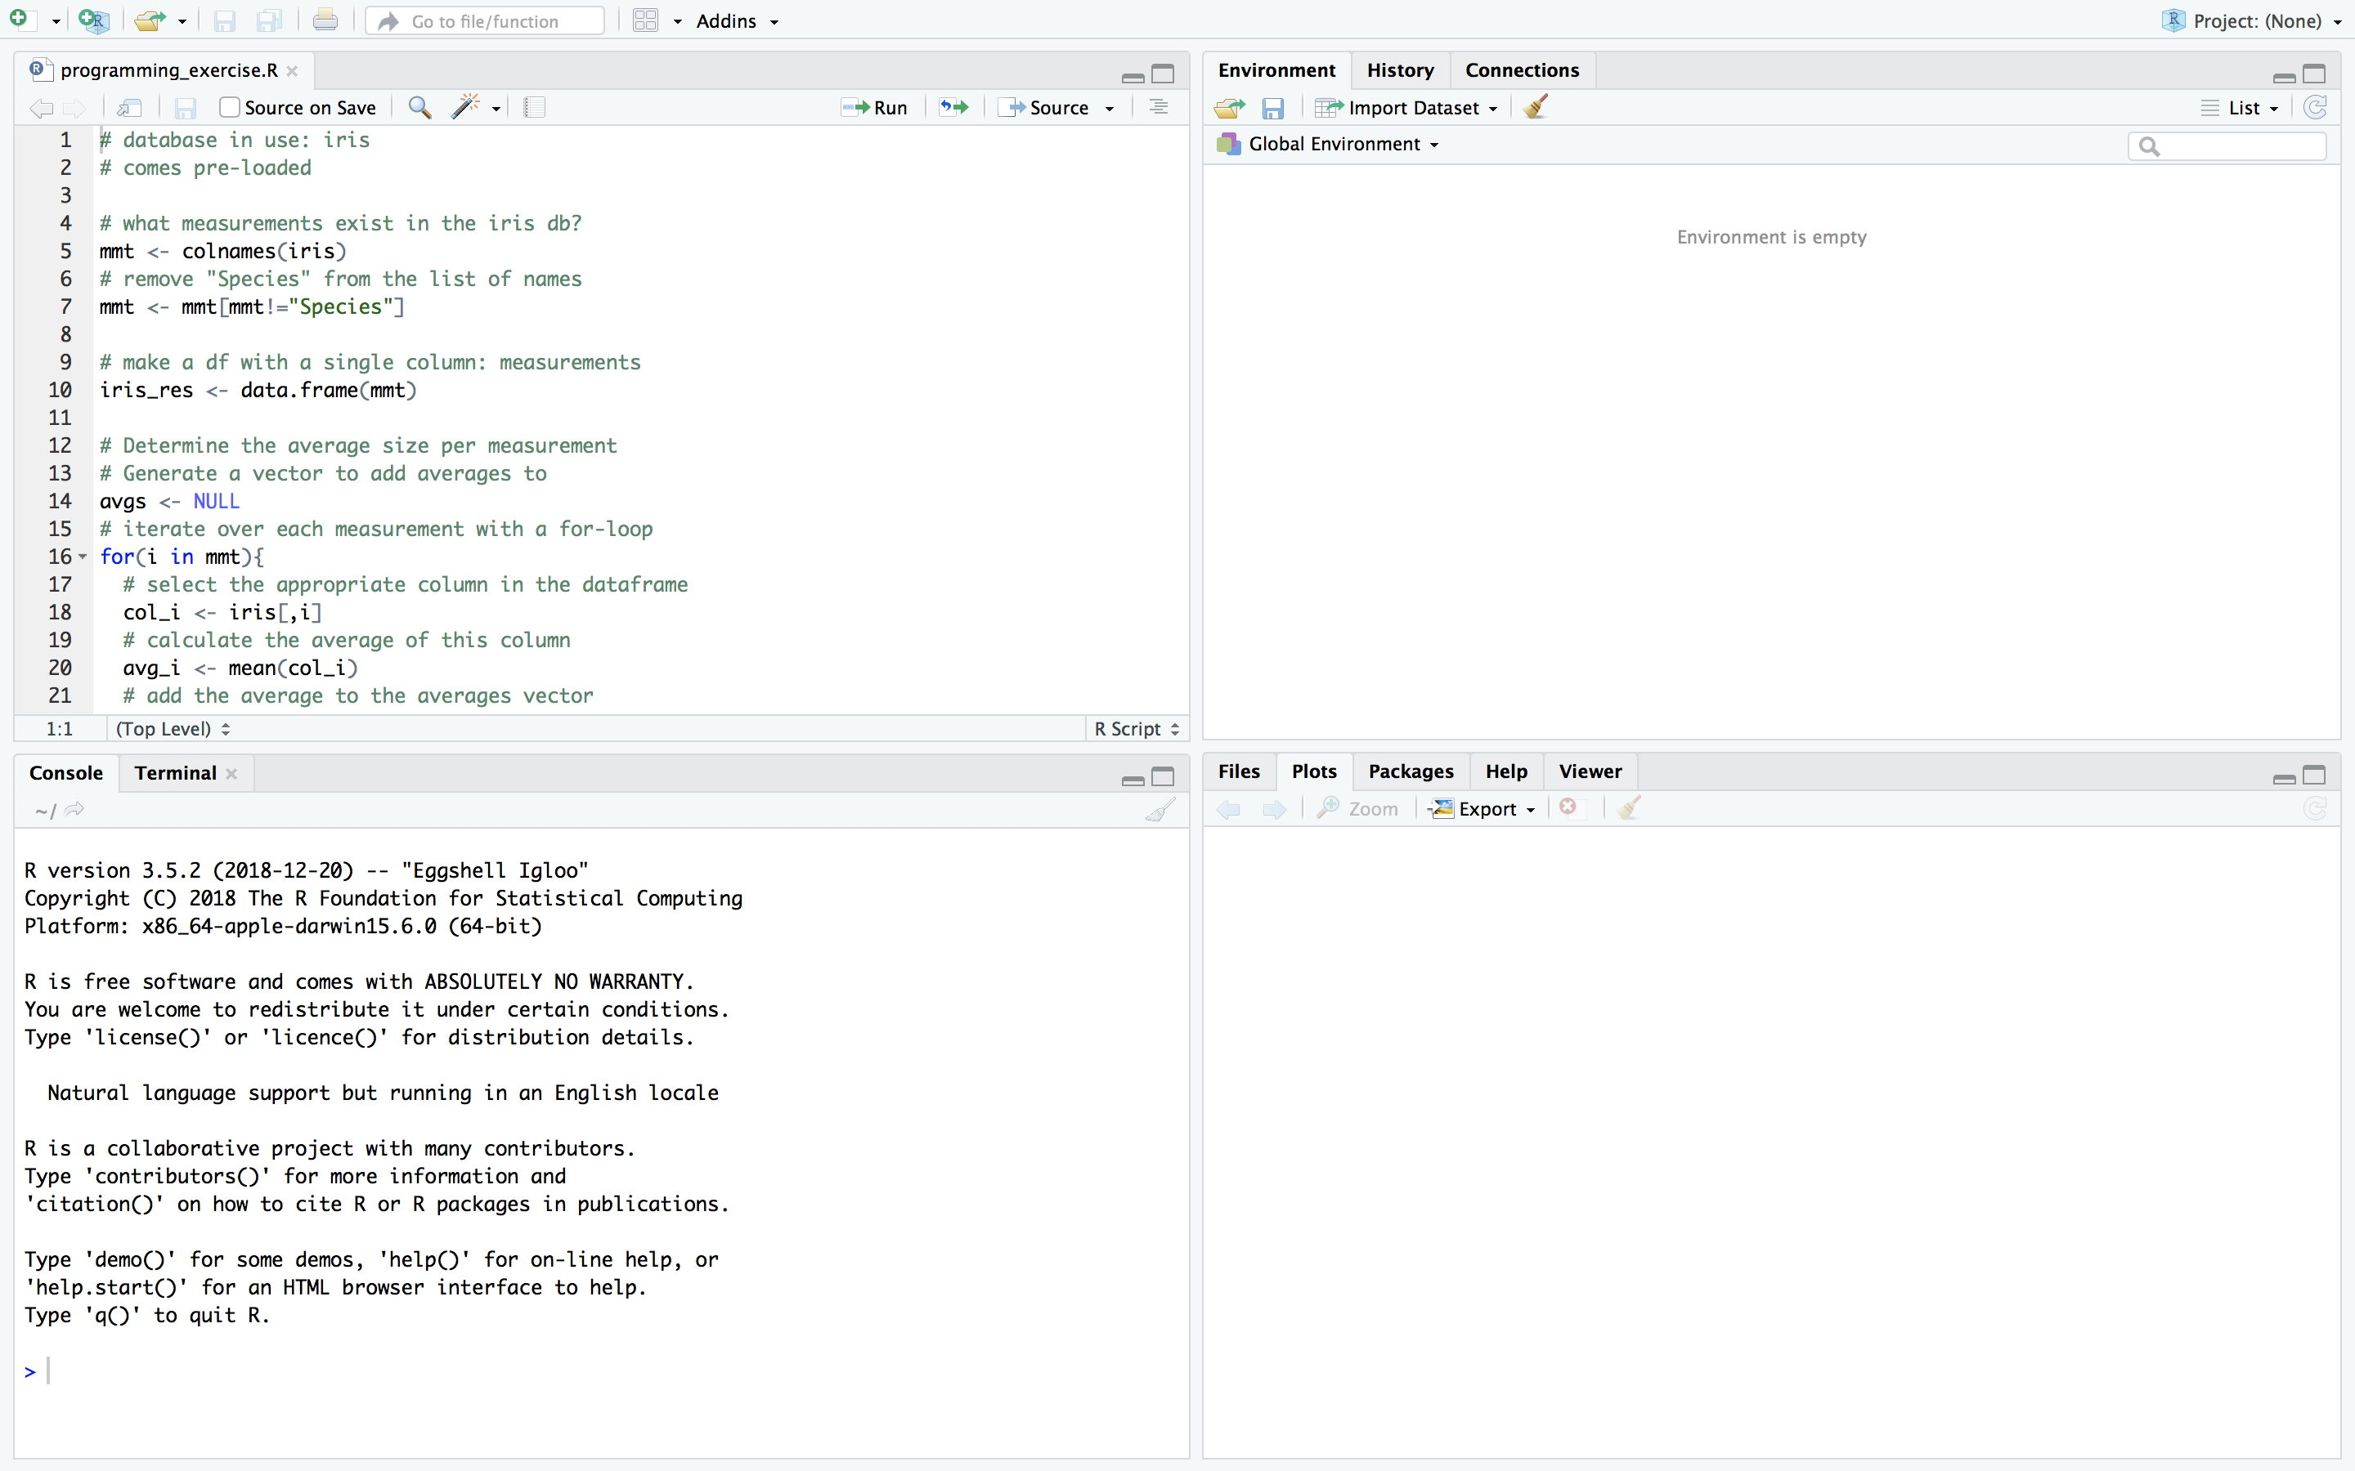
The Rstudio interface
script
markdown
data preview
environment
history
console
files
plots
packages
help

Slide 9
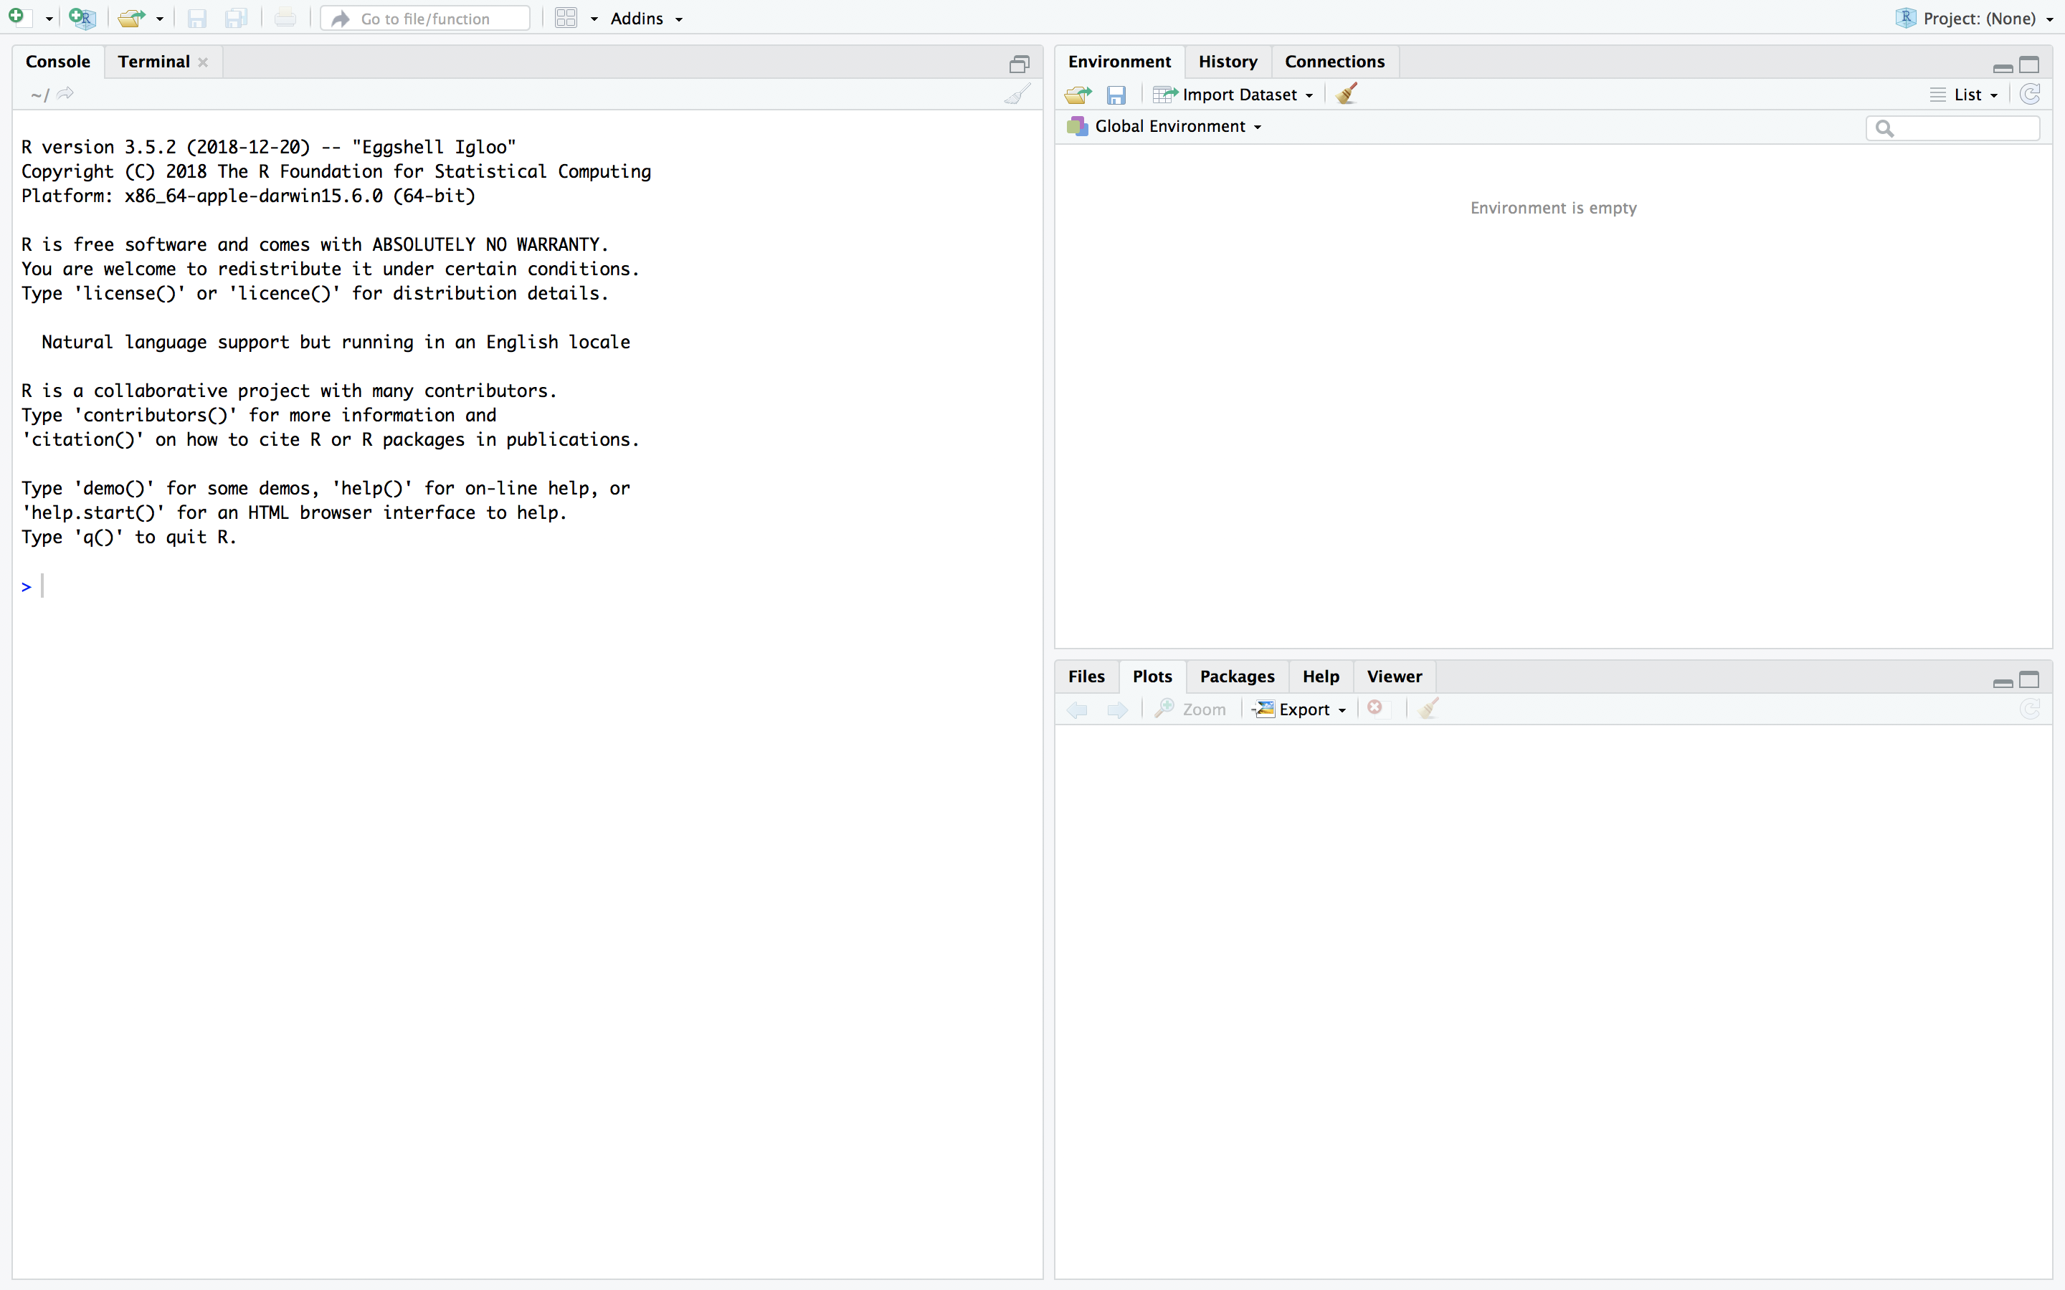
The Rstudio interface
console
environment
history
files
plots
packages
help

Slide 10
Have you downloaded the course material?
Please store it in a single, accessible folder on your computer. Don’t forget to unzip!
tinyurl.com/introRData > >

Slide 11
R syntax & the console
Data types in R
Combining data
First functions

Slide 12
A quick note on notes
The console is for execution, not for storage
Everything we do is on the slides!
BUT: you can store, if you want, by copy-pasting to a text document
Do you want to write notes in between?
# write your notes in the console like this
# using a #hash sign.
# pressing enter will do nothing.
# go ahead and try!

Slide 13
Variable assignment
>

Slide 14
Variable assignment
> x <- 6

Slide 15
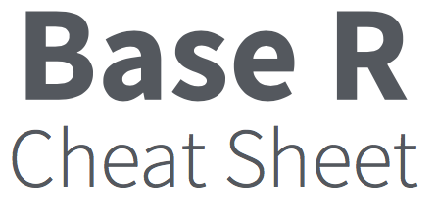
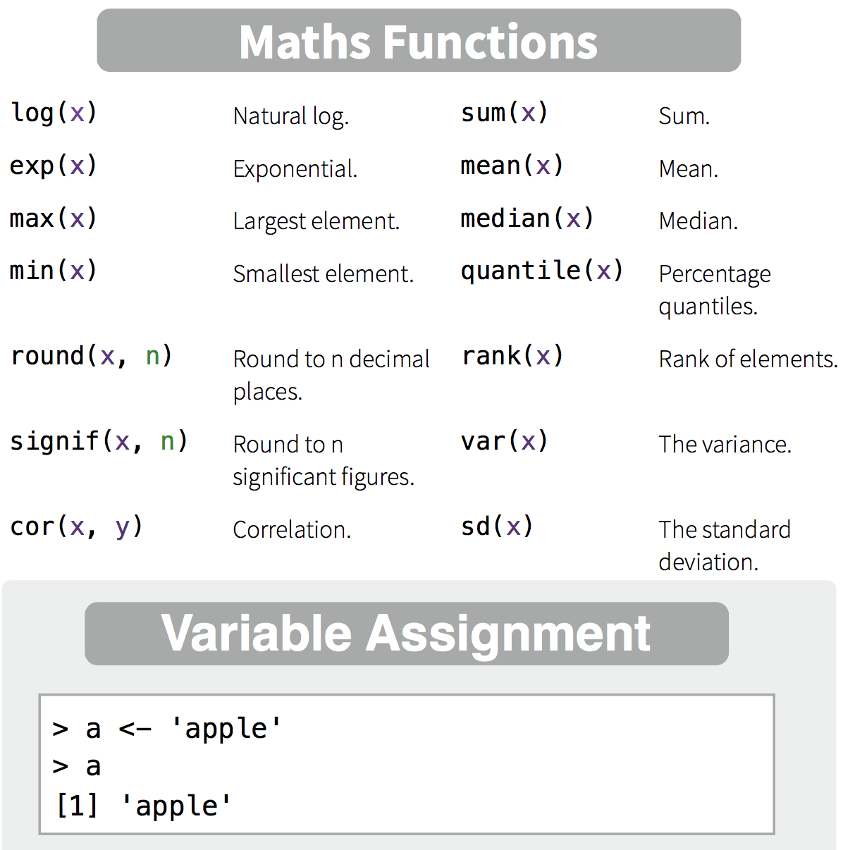
Variable assignment
> x <- 6
> x <- "hi!"
> 6 -> x
> x = 6
> 6 = x
Error in 6 = x : invalid (do_set) left-hand side to assignment

Slide 16
Maths Functions
> x * 3
[1] 18
> y <- x + 2
> log2(y)
[1] 3
Notes:
We can assign values to variables, both numeric and character
We can perform mathematical operations
More complex mathematical operations can be performed using functions.
See your cheatsheet!
You will see that most of these are not operations you can perform on a single number (mean, sum, max, etc). For that, we need another data type.

Slide 17
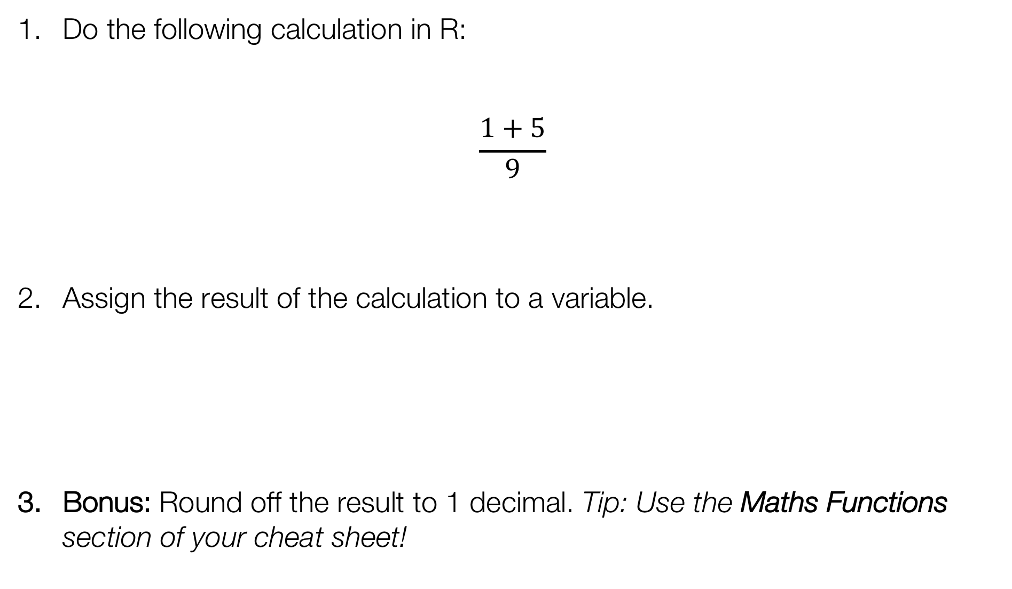
Exercise
Do the following calculation in R:
$$\frac{1+5}{9}$$
Assign the result of the calculation to a variable.
Bonus: Round off the result to 1 decimal. Tip: Use the Maths Functions section of your cheat sheet!

Slide 18
Exercise
Do the following calculation in R:
$$\frac{1+5}{9}$$
Assign the result of the calculation to a variable.
Bonus: Round off the result to 1 decimal. Tip: Use the Maths Functions section of your cheat sheet!
> (1+5)/9
> MyCalc <- (1+5)/9
> round(MyCalc,1)

Slide 19
Another data type: logical
T | TRUE
F | FALSE
> T
[1] TRUE
> F
[1] FALSE
> x==6
[1] TRUE
> 2>4
[1] FALSE
== is equal to
!= is not
>= larger than or equal to
< smaller than

Slide 20
Combining data: creating vectors
> c(1,2,3)
[1] 1 2 3
> c("a","b","c")
[1] "a" "b" "c"
> c(T,TRUE,F)
[1] TRUE TRUE FALSE
a numeric vector
a character vector
a logical vector

Slide 21
Vector functions
> p <- 1:5
> p
[1] 1 2 3 4 5
> mean(p)
[1] 3
> p * 2
[1] 2 4 6 8 10
> q <- 5:1
> q
[1] 5 4 3 2 1
> p * q
[1] 5 8 9 8 5
p * 2
p | 2
1 | 2 | 2
2 | 2 | 4
3 | 2 | 6
4 | 2 | 8
5 | 2 | 10
p * q
p | q
1 | 5 | 5
2 | 4 | 8
3 | 3 | 9
4 | 2 | 8
5 | 1 | 5

Slide 22

Exercise: create vectors
Meet Ann, Bob, Chloe, and Dan.
Make a character vector with their names, using the function c(). Save the vector as name.
How old are Ann, Bob, Chloe, and Dan? Design a numeric vector with their respective ages. Save it as age.
Bonus: What is their average age? Use a function in R to calculate this.

Slide 23
Exercise: create vectors
Meet Ann, Bob, Chloe, and Dan.
Make a character vector with their names, using the function c(). Save the vector as name.
> name <- c("Ann", "Bob", "Chloe", "Dan")
How old are Ann, Bob, Chloe, and Dan? Design a numeric vector with their respective ages. Save it as age.
> age <- c(35,22,50,51)
Bonus: What is their average age? Use a function in R to calculate this.
> mean(age)
[1] 39.5

Slide 24

Vectors and factors
> country <- c("UK","USA","USA","UK")
> country
[1] "UK" "USA" "USA" "UK"
> as.factor(country)
[1] UK USA USA UK
Levels: UK USA
A factor is defined by its levels
(most useful for a category)

Slide 25
Combining data
> name
[1] "Ann" "Bob" "Chloe" "Dan"
> age
[1] 35 22 50 51
> c(name,age)
[1] "Ann" "Bob" "Chloe" "Dan" "35" "22" "50" "51"
> list(name,age)
[[1]]
[1] "Ann" "Bob" "Chloe" "Dan"
[[2]]
[1] 35 22 50 51
> data.frame(name,age)
name age
1 Ann 35
2 Bob 22
3 Chloe 50
4 Dan 51

Slide 26
Vectors, lists, and data frames
 | how many dimensions? | function
vector | 1 | c()
list | any number | list()
data frame | 2 | data.frame()

Slide 27
Exercise: combining data
Create a vector country containing four countries (use at least one duplicate!).
Create a data frame combining name, age, and country, and save it as df.
Bonus: create a list combining name, age, and country.

Slide 28
Exercise: combining data
Create a vector country containing four countries (use at least one duplicate!).
> country <- c("UK","USA","USA","UK")
Create a data frame combining name, age, and country, and save it as df.
> df <- data.frame(name,age,country)
Bonus: create a list combining name, age, and country.
> list(name,age,country)

Slide 29



Data without data: NA
> pet <- c("cat","none","fish",NA)
> pet
[1] "cat" "none" "fish" NA
> as.factor(pet)
[1] cat none fish <NA>
Levels: cat fish none
NA = Not Available
name | age | country | pet
Ann | 35 | UK | cat
Bob | 22 | USA | none
Chloe | 50 | USA | fish
Dan | 51 | UK | NA
In other words:
We know that Bob has no pets.
We do not know if Dan has pets.

Slide 30
Exercise: predict the answer
Predict the results. Does the (real) answer make sense to you?
> 5 == 5
> 5 == NA
> NA == NA

Slide 31
Exercise: predict the answer
Predict the results. Does the (real) answer make sense to you?
> 5 == 5
[1] TRUE
> 5 == NA
[1] NA
> NA == NA
[1] NA
> is.na(NA)
[1] TRUE

Slide 32
Let’s breathe and recap!
What data types have you encountered so far?
logical
numeric
character
How can data be absent?
NA (not available)
NULL (non-existent) coming up!
And what data collections have you encountered?
vector (one dimension)
factor (one dimension, level-based)
data frame (two dimensions)
list (++ dimensions)

Slide 33
Functions
What functions have you encountered so far?
> c()
> as.logical()
> data.frame()
> is.na()
> mean()
...
And do you still know what they mean? And how to use them? No?
> ?mean()
> help.search("standard deviation")
(or use the Help window to the right of your console)

Slide 34
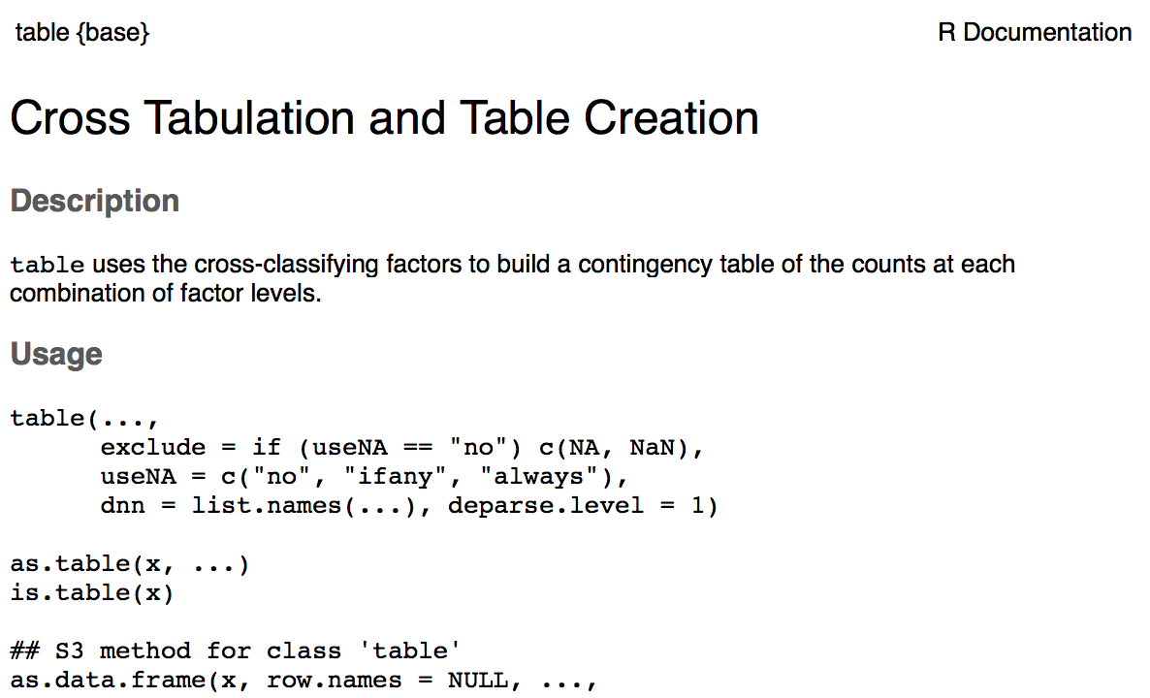
Help!
function & package names
wait what? These are extra arguments. If you see
argument = "default"
then the setting is already specified, so you won’t have to.
how would you use the function?
functions so related they share a help page

Slide 35
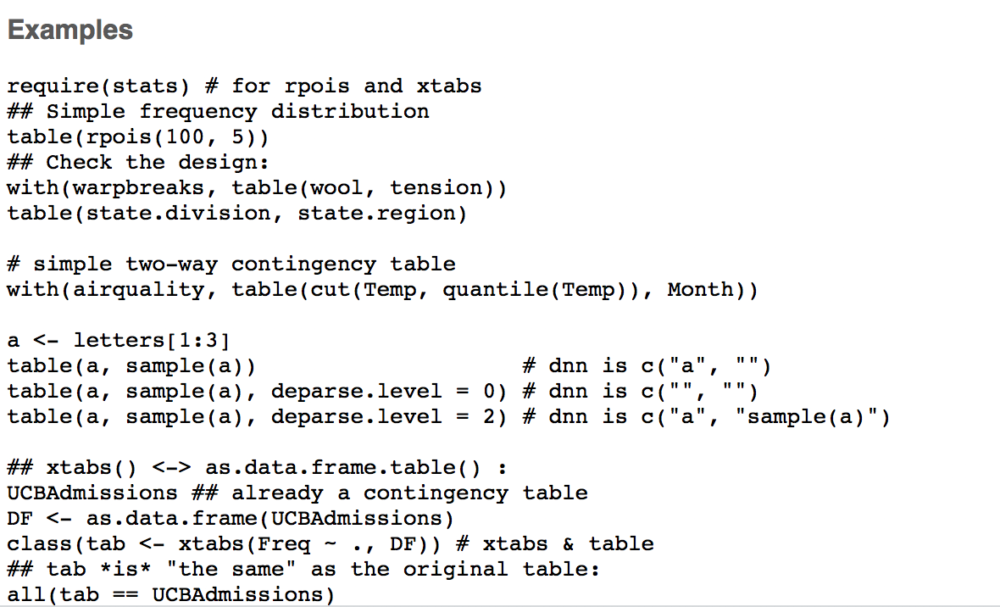
Help? Scroll down!

Slide 36
Take a break!
"Fresh Cup" by mikecpeck

Slide 37
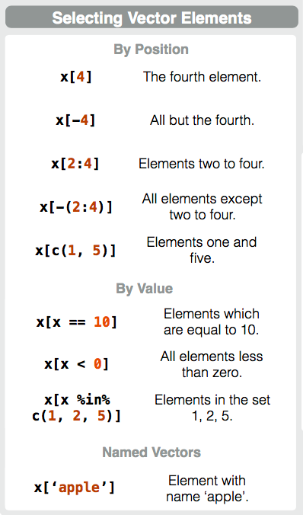
Selecting vector elements by position
> name
[1] "Ann" "Bob" "Chloe" "Dan"
> name[2]
[1] "Bob"
> name[1:3]
[1] "Ann" "Bob" "Chloe"

Slide 38
Selecting vector elements by value
age | age>40 | result
35 | FALSE
22 | FALSE
50 | TRUE | 50
51 | TRUE | 51
> age
[1] 35 22 50 51
> age[age>40]
[1] 50 51
> age>40
[1] FALSE FALSE TRUE TRUE
> name[name %in% c("Chloe","Ann")]
[1] "Ann" "Chloe"
> name[NA]
[1] NA NA NA NA

Slide 39
Exercise
Return only the first number in your vector age.
Return the 2nd and 4th name in your vector name.
Return only ages under 30 from your vector age.

Slide 40
Exercise
Return only the first number in your vector age.
> age[1]
[1] 35
Return the 2nd and 4th name in your vector name.
> name[c(2,4)]
[1] "Bob" "Dan"
Return only ages under 30 from your vector age.
> age[age<30]
[1] 22

Slide 41
Indexing lists
> mylist <- list(name,age)
> mylist
[[1]]
[1] "Ann" "Bob" "Chloe" "Dan"
[[2]]
[1] 35 22 50 51
> mylist[1]
[[1]]
[1] 4 5 6
> mylist[[1]]
[1] 4 5 6
> mylist[[1]][2]
[1] 5
> mylist[1][2]
[[1]]
NULL
select the first list element
select the content of the first list element

Slide 42

NA != NULL
NA
NULL
“None” or 0
Information is Not Available
Information does not exist
Data entry specifying content of 0
Notes:
It's like determining whether there is coffee or tea in cup. None, there is nothing in the cup. NA we don't know what's in there. NULL, there isn't even a cup (we can't put something in there at all).

Slide 43
Exercise: predict the answer
> is.na(NA)
[1] TRUE
> is.null(NULL)
[1] TRUE
Predict the results. Does the (real) answer make sense to you?
> is.null(NA)
> is.na(NULL)

Slide 44
Exercise: predict the answer
> is.na(NA)
[1] TRUE
> is.null(NULL)
[1] TRUE
Predict the results. Does the (real) answer make sense to you?
> is.null(NA)
[1] FALSE
> is.na(NULL)
[1] logical(0)

Slide 45
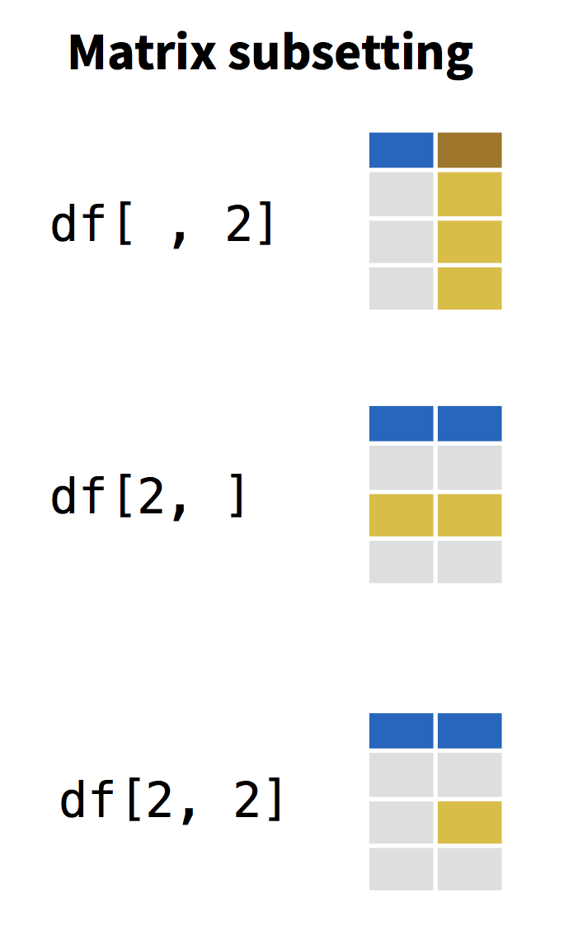


Indexing a data frame
name | age | country
Ann | 35 | UK
Bob | 22 | USA
Chloe | 50 | USA
Dan | 51 | UK
row
column

Slide 46
Indexing a data frame
df[,2]
df[,"age"]
df$age
> df[,2]
[1] 35 22 50 51
> df[,"age"]
[1] 35 22 50 51
> df$age
[1] 35 22 50 51
> df[2,]
name age country
2 Bob 22 USA
> df[df$name=="Bob",]
name age country
Bob 25 USA
> df[df$name=="Bob","age"]
[1] 22
name | age | country
Ann | 35 | UK
Bob | 22 | USA
Chloe | 50 | USA
Dan | 51 | UK
df[2,]
df[df$name=="Bob",]

Slide 47
Remove variables
Before we start with the exercise, please remove the vectors that were the basis of your data frame from your environment, like this:
> rm(name,age,country)
(We do this so they cannot confuse you during the following exercise!)

Slide 48
Exercise
From your dataframe df, return the entries for everyone living in a country of your choice.
Return only the names of everyone in your data frame df under 40.
(Hint: what information should you use for row indexing?
What information should you use for column indexing?)
Bonus: can you use vector indexing on a column to achieve the same result?

Slide 49



Exercise
From your dataframe df, return the entries for everyone living in a country of your choice.
> df[df$country=="USA",]
name age country
2 Bob 22 USA
3 Chloe 50 USA
Return only the names of everyone in your data frame df under 40.
(Hint: what information should you use for row indexing?
What information should you use for column indexing?)
> df[df$age<40,"name"]
> df[df$age<40,1]
[1] Ann Bob
Levels: Ann Bob Chloe Dan
Bonus: can you use vector indexing on a column to achieve the same result?
> df$name[df$age<40]
indexing the dataframe df
indexing the vector df$name

Slide 50
Which bracket does what?
[ ]
( )
{ }
Indexing vectors, lists, dataframes…
Passing arguments to functions
Defining content of loops, functions, etc.

Slide 51
Programming
Writing your first script
Programming with loops and functions
Handling and processing a dataset

Slide 52
Introducing a sample dataset
Dataset: ‘iris’
Standard dataset in R, measurements on 3 species of iris flowers
Iris setosa
Iris versicolor
Iris virginica

Slide 53
Introducing a sample dataset
Dataset: ‘iris’
Standard dataset in R, measurements on 3 species of iris flowers
> head(iris)
Sepal.Length Sepal.Width Petal.Length Petal.Width Species
1 5.1 3.5 1.4 0.2 setosa
2 4.9 3.0 1.4 0.2 setosa
3 4.7 3.2 1.3 0.2 setosa
4 4.6 3.1 1.5 0.2 setosa
5 5.0 3.6 1.4 0.2 setosa
6 5.4 3.9 1.7 0.4 setosa
> summary(iris)
Sepal.Length Sepal.Width Petal.Length Petal.Width Species
Min. :4.300 Min. :2.000 Min. :1.000 Min. :0.100 setosa :50
1st Qu.:5.100 1st Qu.:2.800 1st Qu.:1.600 1st Qu.:0.300 versicolor:50
Median :5.800 Median :3.000 Median :4.350 Median :1.300 virginica :50
Mean :5.843 Mean :3.057 Mean :3.758 Mean :1.199
3rd Qu.:6.400 3rd Qu.:3.300 3rd Qu.:5.100 3rd Qu.:1.800
Max. :7.900 Max. :4.400 Max. :6.900 Max. :2.500
Notes:
Recognize factor and numeric data

Slide 54
Exercise
Explore the iris dataframe, using some of the following functions:
head()
tail()
names()
summary()
dim()
str()
Can you figure out what these functions do? What do they teach you about the kind of data in iris?

Slide 55
Console and Scripts
Console | Code execution | -
Script | Code | Extension: .R (example_script.R)
Rmarkdown | Code + Narrative | Extension: .Rmd (example_report.Rmd)

Slide 56
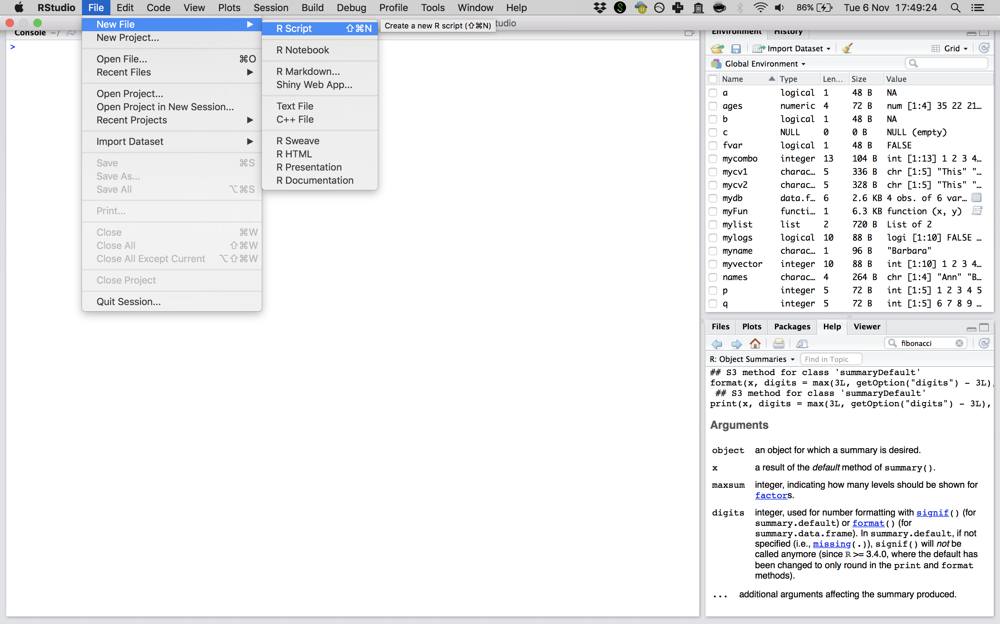
Ready to script? [demo!]
RStudio > File > New File > R Script
Notes:
SHow how to write a script and execute lines right away!

Slide 57




Console vs script on our slides
> x <- 1
> x
[1] 1
# Assigning the value 1 to x
x <- 1
writing in the console
console output
# indicates comment
computer stops reading (but you should not!)

Slide 58
Programming: functions
Multiple instructions that form a cohesive unit
Should be able to be repeated on different inputs
add up all elements
in
count all elements
mean()
divide: sum/count
out

Slide 59
Live exercise: the assembly line of a function
in: a blank card
place a stamp
draw a wiggle
pretty_card()
cut a deco
out: pretty!
Notes:
Place behind a whiteboard, name the assembly line!

Slide 60
How would this look in R?
pretty_card <- function(x){
x <- place_stamp(x)
x <- draw_wiggle(x)
x <- cut_deco(x)
return(x)
}
> pretty_card( )
[1] 1

Slide 61
Programming: functions
myFun <- function(x,y){
z <- x*y
return(z)
}
> myFun(2,4)
[1] 8

Slide 62
Exercise
Write a function that takes a vector as input, and returns the mean of this vector (you can use the existing function mean() inside your function).
apply_calc <- function(...){
...
return(...)
}
Add further options to your function:
for example, the standard deviation (sd()), the minimum (min()), and the maximum (max()) of your input vector.
Put all of these calculations in a vector using the function c(), and return this result vector.
apply_calc <- function(...){
...
allres <- c(...)
return(...)
}

Slide 63
Exercise
Write a function that takes a vector as input, and returns the mean of this vector (you can use the existing function mean() inside your function).
apply_calc <- function(x){
m <- mean(x)
return(m)
}
Add further options to your function:
for example, the standard deviation (sd()), the minimum (min()), and the maximum (max()) of your input vector.
Put all of these calculations in a vector using the function c(), and return this result vector.
apply_calc <- function(x){
m <- mean(x)
s <- sd(x)
mi <- min(x)
ma <- max(x)
allres <- c(m,s,mi,ma)
return(allres)
}

Slide 64
Applying apply_calc
apply_calc <- function(x){
m <- mean(x)
return(m)
}
> apply_calc(iris$Sepal.Length)
[1] 5.8433333
apply_calc <- function(x){
m <- mean(x)
s <- sd(x)
mi <- min(x)
ma <- max(x)
allres <- c(m,s,mi,ma)
return(allres)
}
> apply_calc(iris$Sepal.Length)
[1] 5.8433333 0.8280661 4.3000000 7.9000000

Slide 65
Live exercise: the repeated action in a for-loop
for every card
in this collection…
cut a deco
Notes:
Name the collection!

Slide 66
How would this look in R?
for(i in ){
cut_deco(i)
}
[1] 1
[1] 2
[1] 3
[1] 4
[1] 5
[1] 6
for(i in 1:6){
print(i)
}
[1] 1
[1] 2
[1] 3
[1] 4
[1] 5
[1] 6

Slide 67
Exercise
Make a vector with all the column names in iris.
Hint: use the function colnames().
iriscols <- ...
Make a for-loop that iterates over all the column names in iris, and prints these column names.
for(...){
...
}
Elaborate on this for-loop: select the corresponding column in iris, and print the mean. Hint: yes, you should get a warning! Do you understand why?
for(...){
...
}

Slide 68
Exercise
Make a vector with all the column names in iris.
Hint: use the function colnames().
iriscols <- colnames(iris)
Make a for-loop that iterates over all the column names in iris, and prints these column names.
for(i in iriscols){
print(i)
}
Elaborate on this for-loop: select the corresponding column in iris, and print the mean. Hint: yes, you should get a warning! Do you understand why?
for(i in iriscols){
c <- iris[,i]
stat <- mean(c)
print(stat)
}

Slide 69
What’s wrong? And how do we fix it?
for(i in iriscols){
# select the appropriate column
c <- iris[,i]
# calculate the mean
stats <- mean(c)
# print the mean
print(stats)
}
[1] 5.843333
[1] 3.057333
[1] 3.758
[1] 1.199333
[1] NA
Warning message:
In mean.default(c) : argument is not numeric or logical: returning NA

Slide 70
Live exercise: the selectivity of an if-statement
for every card
in this collection…
is it yellow?
yes
cut a deco
no
stamp
PS: note how this is still a for-loop? That’s not a requirement!

Slide 71
How would this look in R?
for(i in ){
if(x == y){
cut_deco(i)
} else{
stamp(i)
}
}
[1] 1
[1] 2
[1] 3
[1] 4
[1] 5
[1] 6
for(i in 1:6){
if(i > 3){
print("Large!")
} else{
print("small...")
}
}
[1] "small..."
[1] "small..."
[1] "small..."
[1] "Large!"
[1] "Large!"
[1] "Large!"

Slide 72
Programming: if-statement
d <- 5
if(is.na(d)){
print("My data is missing!")
} else if(is.null(d)){
print("My data does not even exist...")
} else{
print("I have data!")
}
[1] "I have data!"

Slide 73
Exercise: choose one!
Copy-paste the for-loop you made in the previous exercise. Inside this for-loop, add an if-statement, so that mean() is only performed on numeric vectors. Hint: check the function is.numeric().
for(i in iriscols){
c <- iris[,i]
...
}
Are you feeling comfortable with the material?
Open the file ‘programming_exercise.R’
Read through the code, see if you understand it (it is mostly the previous two exercises, but with some small tweaks!)
Scroll down to line 32 for the exercise.
Read the bonus material — you can check your work with the code there.

Slide 74
Exercise: choose one!
Copy-paste the for-loop you made in the previous exercise. Inside this for-loop, add an if-statement, so that mean() is only performed on numeric vectors. Hint: check the function is.numeric().
for(i in iriscols){
c <- iris[,i]
if(is.numeric(c)){
stat <- mean(c)
print(stat)
}
}
Are you feeling comfortable with the material?
Open the file ‘programming_exercise.R’
Read through the code, see if you understand it (it is mostly the previous two exercises, but with some small tweaks!)
Scroll down to line 32 for the exercise.
Read the bonus material — you can check your work with the code there.

Slide 75
Data science workflow: scripting is crucial
Scripting combines commands to a comprehensive set of instructions.
A script is code that can be saved, reused, shared, published!
In short: a crucial step towards reproducible data analysis.
a single script for a single purpose!

Slide 76
Starting the script: write a header
## Date: 7 November 2018
## Author: Barbara Vreede
## This script was written as part of the R course
## "Introduction to R & Data", at Utrecht University
Notes:
Think about: dependencies, version, purpose…

Slide 77
Load packages and dependencies
## Date: 7 November 2018
## Author: Barbara Vreede
## This script was written as part of the R course
## "Introduction to R & Data", at Utrecht University
# Load required packages
library(dplyr)
library(tidyr)
library(ggplot2)

Slide 78
Custom functions
## Date: 7 November 2018
## Author: Barbara Vreede
## This script was written as part of the R course
## "Introduction to R & Data", at Utrecht University
# Load required packages
library(dplyr)
library(tidyr)
library(ggplot2)
# Functions
myFun <- function(var){
var <- var*2*pi
return(var)
}

Slide 79
Starting your script: header, packages, functions
## Date: 7 November 2018
## Author: Barbara Vreede
## This script was written as part of the R course
## "Introduction to R & Data", at Utrecht University
# Load required packages
library(dplyr)
library(tidyr)
library(ggplot2)
# Functions
myFun <- function(var){
var <- var*2*pi
return(var)
}

Slide 80
To check before lunch: please load tidyverse
> library(tidyverse)
── Attaching packages ─────────────────────── tidyverse 1.2.1 ──
✔ ggplot2 3.1.0 ✔ purrr 0.3.0
✔ tibble 2.0.1 ✔ dplyr 0.7.8
✔ tidyr 0.8.2 ✔ stringr 1.4.0
✔ readr 1.3.1 ✔ forcats 0.3.0
── Conflicts ────────────────────────── tidyverse_conflicts() ──
✖ dplyr::filter() masks stats::filter()
✖ dplyr::lag() masks stats::lag()

Slide 81
Enjoy your lunch!

